Slide 1
νZ – Maximal Satisfaciton with Z3
Nikolaj Bjørner Phan Anh Dung
Microsoft Research DTU

Slide 2

First some Propaganda

Slide 3

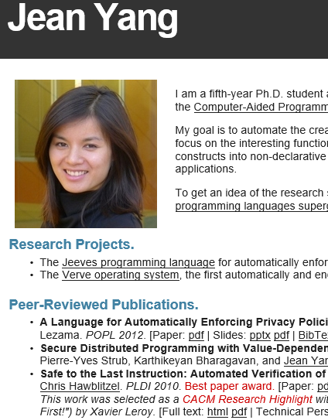
This could be you
if you use Z3

Slide 4

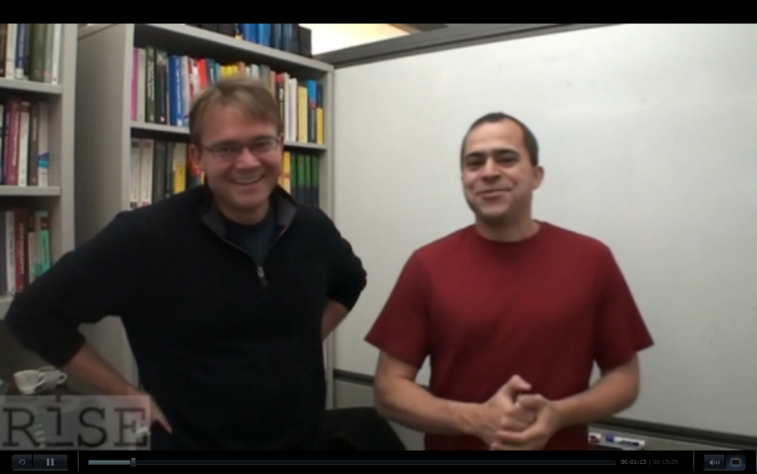

– Backed by Proof Plumbers
Leonardo de Moura, Nikolaj Bjørner, Christoph Wintersteiger

Slide 5


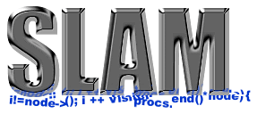
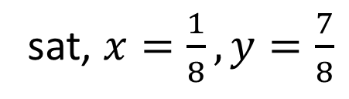
Symbolic Analysis with
Solution/Model
sat, $x=\frac{1}{8}, y=\frac{7}{8}$
$x^{2}+y^{2}<1 and xy>0.1$
$x^{2}+y^{2}<1 and xy>1$
unsat, Proof
Is execution path P feasible?
Does Policy Satisfy Contract?
WI
TNESS
Z3 used by Pex,
Static Driver Verifier, many other tools
SAGE
SecGuru
Z3 solved more than 10 billion constraints created by SymEx tools including SAGE
checking Win8 and Office
Is Formula F Satisfiable?
Notes:
Models are very important.
Classical theorem provers do not produce models

Slide 6






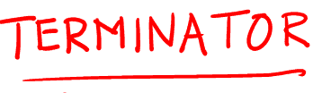


Symbolic Analysis Engines
SecGuru
SLS, floats
νZ: Opt+MaxSMT
μZ: Datalog
Generalized PDR
Existential Reals
Model Constructing SAT
CutSAT: Linear Integer Formulas
SAGE
Quantified Bit-Vectors
Linear Quantifier Elimination
Model Based Quantifier Instantiation
Generalized, Efficient Array Decision Procedures
HAVOC
Engineering DPLL(T) + Saturation
Effectively Propositional Logic
Model-based Theory Combination.
Relevancy Propagation
Efficient E-matching for SMT solvers
Internals
Notes:
Models are very important.
Classical theorem provers do not produce models

Slide 7
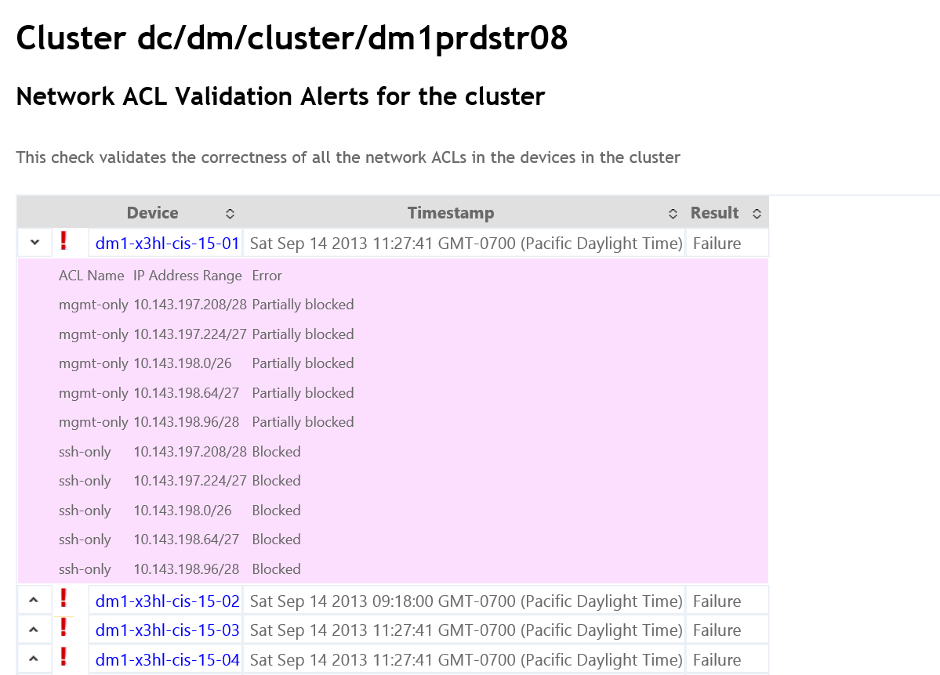
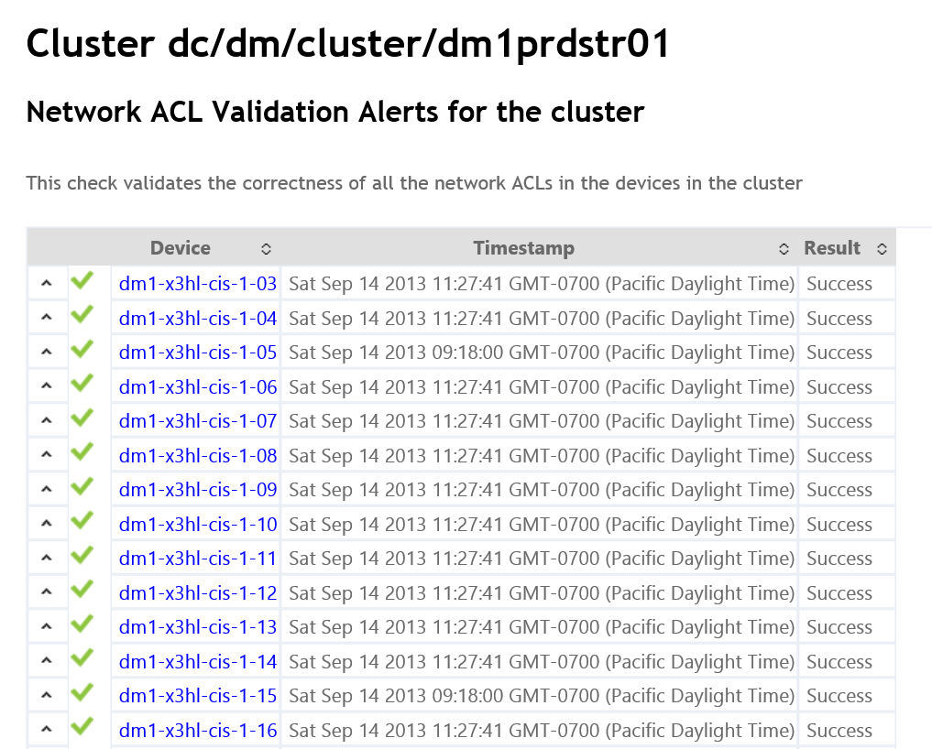
SecGuru in WANetmon
40,000 ACL checks per month
Each check 50-200ms
20 bugs/month (mostly for build-out)

Slide 8
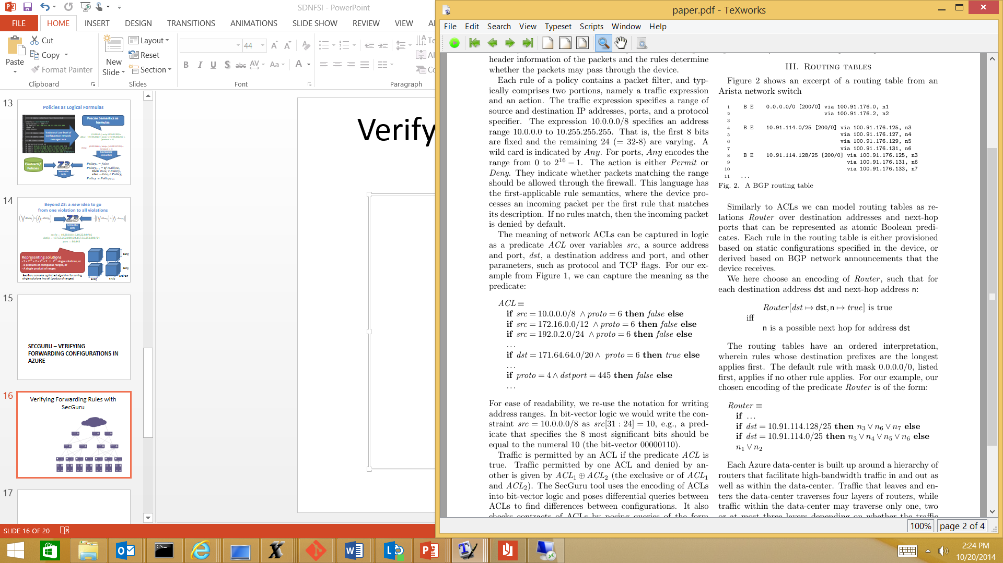
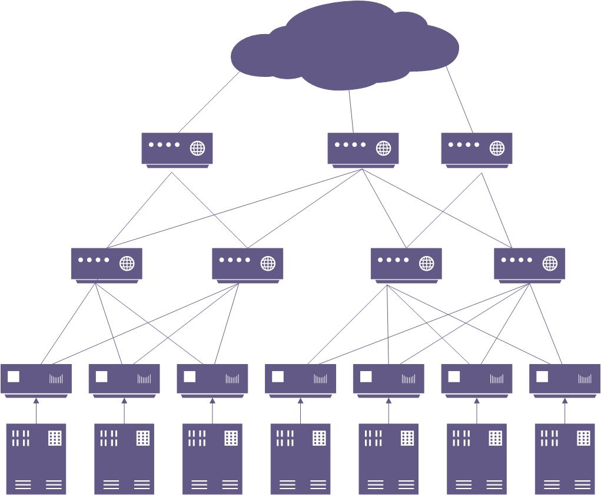
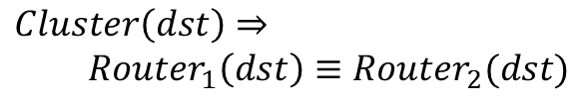
Verifying Forwarding Rules with SecGuru
Routes
Logic
Contract
$Cluster\left(dst\right)⇒$
$Router_{1}\left(dst\right)≡Router_{2}(dst)$

Slide 9
Now on to + Optimization

Slide 10


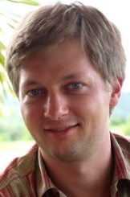
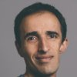



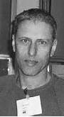
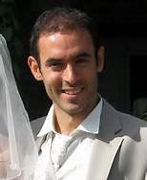
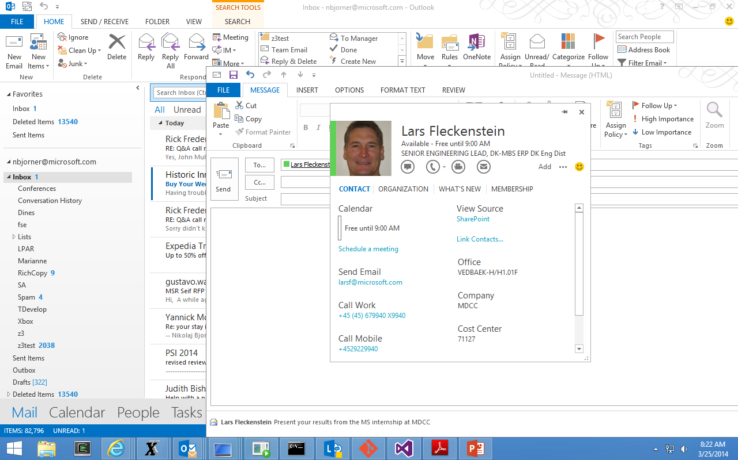

My νZ is bigger than your μZ!
νZ is a Z3 module for SMT with objective functions
A new tool for Z3 user scenarios
Vampire tuning
Theorem prover
tuning
DNA alignment
Longest
Paths
for static analysis
Multi
Proc.
Code
RNA
synth
Chip
Design for
Energy
Saving
Materials
discovery
Max profit
goods
packing

Slide 11
Introducing νZ
SMT users want/need many things:
Solve classes of quantifiers (Horn, EPR)
Solve non-linear, transcendental arithmetic
Solve floating point numbers
Solve string and grammar constraints
Solve faster, bigger, better, …
Sometimes some solutions are better than others.

Slide 12
Introducing νZ
νZ integrates objective functions
νZ = SMT + optimization algorithms
Is meant to make objectives accessible to Z3 users
Based on CDCL technologies
νZ is soliciting applications. It is “soon” integrated with main Z3 branch, but so-far available from a branch called “opt”.

Slide 13
Roadmap
νZ functionality
Optimizing Solvers
νZ for Linear Arithmetic
νZ and MaxSAT
Combining
Objectives

Slide 14
νZ functionality
νZ functionality
νZ functionality
Maximize, Minimize
Terms over integers, reals, bit-vectors
Weighted Soft Constraints
Combine Multiple Objectives
Lexicographic, Pareto, Box

Slide 15
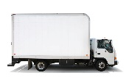

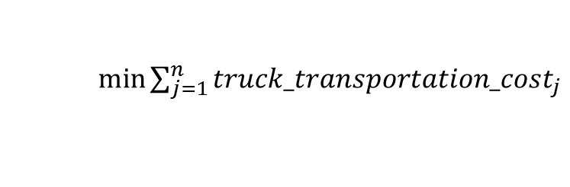
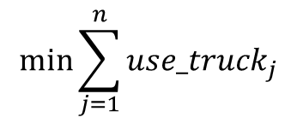
A Transportation Planning Example
 | Weight (kg) | Volume (m³) | Delivery date | Firm delivery date | Product type | Post code
Order line 1 | 400 | 300 | 27/09/2013 | 29/09/2013 | Dry | 2112
Order line 2 | 300 | 350 | 26/09/2013 | 29/09/2013 | Fresh | 2100
Order line 3 | 200 | 160 | 28/09/2013 | 30/09/2013 | Dry | 2103
 | Weight (kg) | Volume (m³) | Delivery date | Post code range | Initial cost (USD) | Extra cost (post cost -> USD) | Transportation requirement
Truck 1 | 777 | 700 | 28/09/2013 | 2100, 2103 | 100 | {2100 -> 21, 2103 -> 31} | Dry
Truck 2 | 450 | 1000 | 29/09/2013 | 2100, 2103, 2112 | 120 | {2100 -> 5, 2103 -> 10, 2112 -> 15} | Fresh
Truck 3 | 600 | 460 | 30/09/2013 | 2100, 2112 | 130 | {2100 -> 1, 2103 -> 2, 2112 -> 4} | Dry
$$\min{\sum_{j=1}^{n}{use_truck_{j}}}$$
$\min{\sum_{j=1}^{n}{truck_transportation_cost_{j}}}$

Slide 16
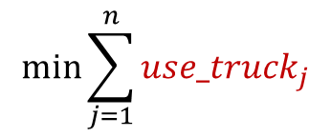

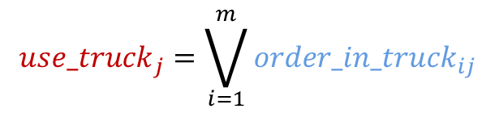
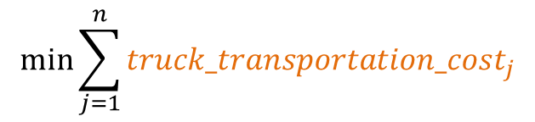
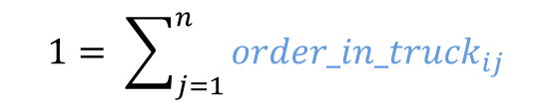
A Transportation Planning Example
$$1= \sum_{j=1}^{n}{{order_in_truck}_{ij}}$$
$${use_truck}_{j}=\bigvee_{i=1}^{m}{{order_in_truck}_{ij}}$$
$${truck_weight}_{j}≥\sum_{i=1}^{m}{{order_in_truck}_{ij}∗{order_weight}_{i}}$$
$${truck_volume}_{j}≥\sum_{i=1}^{m}{{order_in_truck}_{ij}∗{order_volume}_{i}}$$
$$truck_transportation_cost_{j}=\sum_{i=1}^{m}{order_in_truck_{ij}∗extra_cost_{j}}$$
$$\min{\sum_{j=1}^{n}{use_truck_{j}}}$$
$$\min{\sum_{j=1}^{n}{truck_transportation_cost_{j}}}$$

Slide 17
νZ functionality
Three main SMT-LIB2 extensions:
(maximize (+ x (* 2 y)))
(minimize (- x z))
(assert-soft (> x y) :weight 4)

Slide 18
νZ by example
(declare-const x Int)
(declare-const y Int)
(assert (or (> x (+ y 2)) (> y (+ x 3))))
(assert (=> (> x y) (> 10 x)))
(assert (=> (> y x) (> 10 y)))
(check-sat)
(get-model)
(declare-const x Int)
(declare-const y Int)
(assert (or (> x (+ y 2)) (> y (+ x 3))))
(assert (=> (> x y) (> 10 x)))
(assert (=> (> y x) (> 10 y)))
(maximize (+ x (* 2 y)))
(check-sat)
(get-model)
sat
(model
(define-fun y () Int
0)
(define-fun x () Int
(- 4))
)
(+ x (* 2 y)) |-> 23
sat
(model
(define-fun y () Int
9)
(define-fun x () Int
5)
)

Slide 19
Python too
(declare-const x Int)
(declare-const y Int)
(assert (or (> x (+ y 2)) (> y (+ x 3))))
(assert (=> (> x y) (> 10 x)))
(assert (=> (> y x) (> 10 y)))
(check-sat)
(get-model)
from z3 import *
x, y = Ints('x y')
opt = Optimize()
opt.add(Or(x > y + 2, y > x + 3))
opt.add(Implies(x > y, 10 > x))
opt.add(Implies(y > x, 10 > y))
h = opt.maximize(x + 2 * y)
opt.check()
print opt.model()
print h.value()
sat
(model
(define-fun y () Int
0)
(define-fun x () Int
(- 4))
)
[y = 9, x = 5]
23

Slide 20
Mixing Theories and Objective Functions
Possible future scenarios:
Taxonomy | Objective functions | Theories
MaxSAT | Cardinality | Any
WeightedMaxSAT | Pseudo-Boolean | Any
Difference Logic Optimization (Network Simplex) | Linear Arithmetic | Difference Logic
Linear Arithmetic Optimization | Linear Arithmetic | Linear Arithmetic
Quadratic Optimization | Non-linear Arithmetic | Linear Arithmetic
Non-linear Optimization | Non-linear Arithmetic | Non-linear Arithmetic

Slide 21
Optimizing Solvers
Optimizing Solvers
SAT and Pseudo Boolean
MAXSAT
LP, IP, MILP, CSP
MIPLIB
SMT solvers
Z3, Yices, MathSAT
SMTLIB

Slide 22
Optimizing Solvers
(in)equalities, special cuts
SAT and Pseudo Boolean
MAXSAT
LP, IP, MILP, CSP
MIPLIB
0-1 variables
SMT solvers
Z3, Yices, MathSAT
SMTLIB

Slide 23
Optimizing Solvers
SAT and Pseudo Boolean
MAXSAT
LP, IP, MILP, CSP
MIPLIB
Modeling with SMT
SMT solvers
Z3, Yices, MathSAT
SMTLIB

Slide 24
Optimizing Solvers
SAT and Pseudo Boolean
MAXSAT
LP, IP, MILP, CSP
MIPLIB
Expressive Power
OptiMathSAT uses MAXSAT solvers
SMT solvers
Z3, Yices, MathSAT
SMTLIB
WPM2 uses Yices

Slide 25
Optimizing Solvers
(in)equalities, special cuts
SAT and Pseudo Boolean
MAXSAT
LP, IP, MILP, CSP
MIPLIB
0-1 variables
Modeling with
SMT
Expressive Power
OptiMathSAT uses MAXSAT solvers
SMT solvers
Z3, Yices, MathSAT
SMTLIB
WPM2 uses Yices

Slide 26
Optimizing Solvers
MILP programming
Leading tools are much better tuned for large systems of inequalities (LRU decomposition, floats, cuts)
Really good esp. for crafted MaxSAT benchmarks.
Many PB solvers use tuned SAT solvers or CSP systems.
Yices supported MaxSMT since 2005.
OptiMathSAT built around MathSAT, uses MAXSAT solvers.
WPM2 uses Yices (thanks to its LIA support).

Slide 27
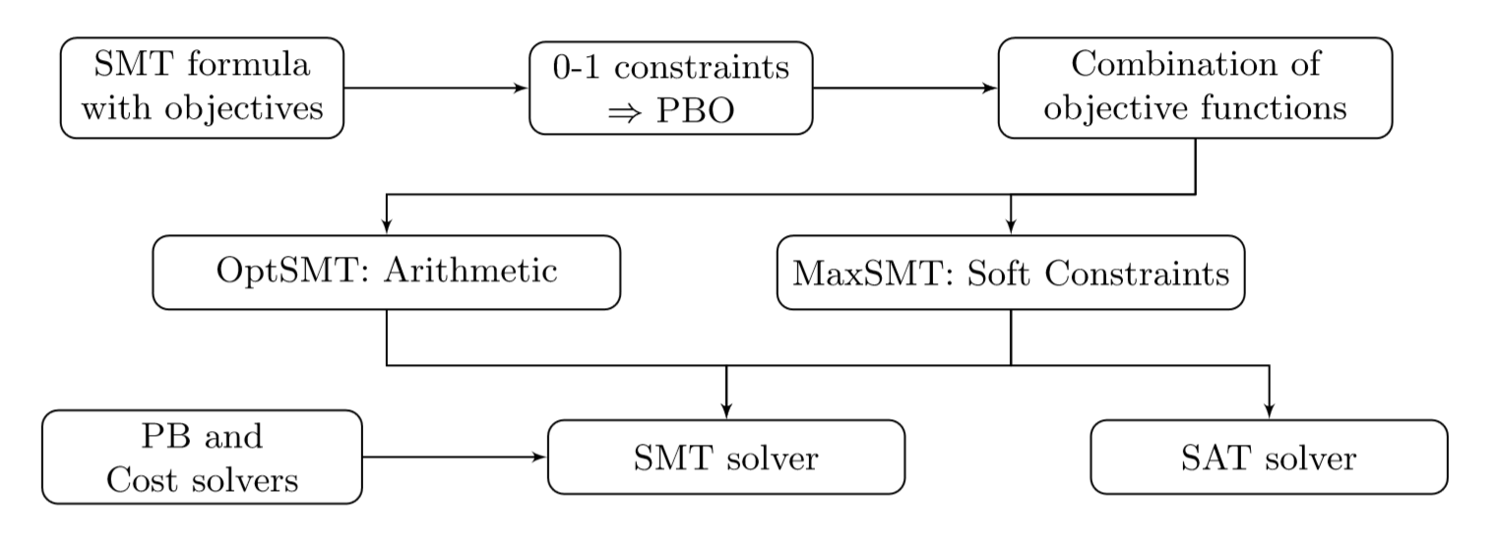
νZ system architecture

Slide 28
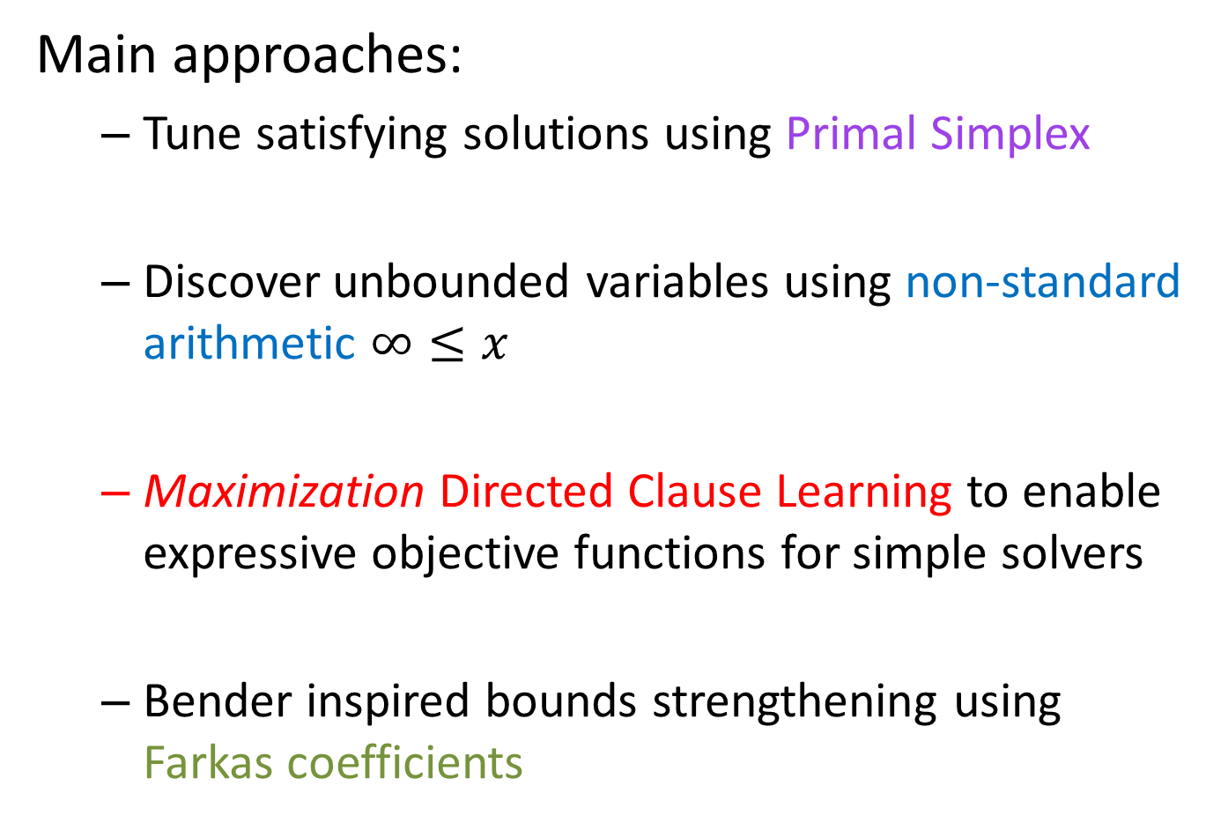
νZ for Arithmetic
νZ for Linear Arithmetic
Main approaches:
Tune satisfying solutions using Primal Simplex
Discover unbounded variables using non-standard arithmetic $∞≤x$
Maximization Directed Clause Learning to enable expressive objective functions for simple solvers
Bender inspired bounds strengthening using Farkas coefficients

Slide 29
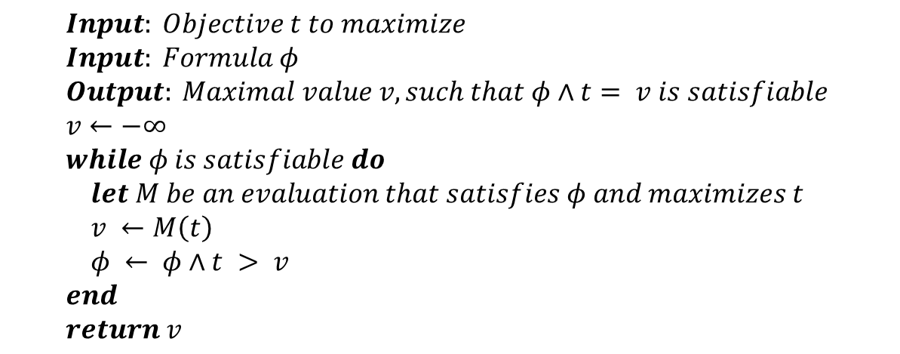
νZ Basic Arithmetic
Primal Simplex
$$Input: Objective t to maximize \\ Input: Formula φ \\ Output: Maximal value v, such that φ∧t= v is satisfiable \\ v←−∞ \\ while φ is satisfiable do \\ let M be an evaluation that satisfies φ and maximizes t \\ v ←M\left(t\right) \\ φ ← φ∧t > v \\ end \\ return v$$
Use primal Simplex to maximize $t$
[Explored in OptiMathSAT]

Slide 30
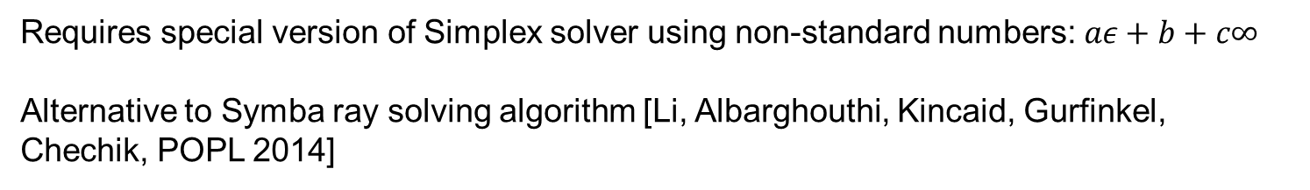
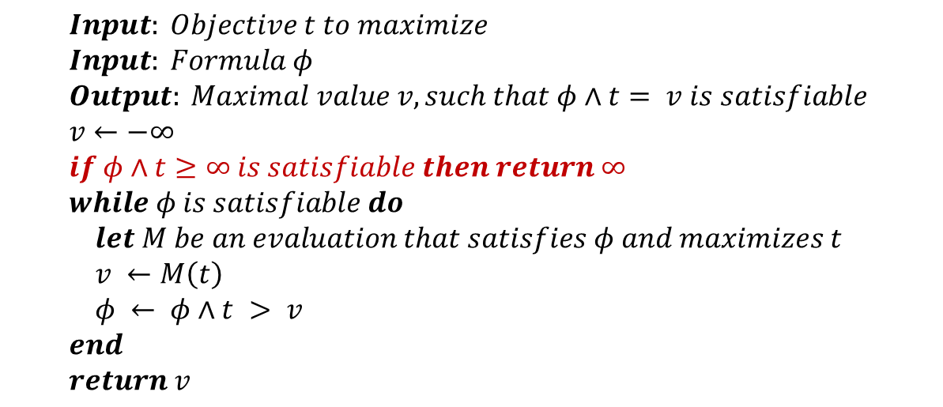
νZ Non-standard Arithmetic
non-standard arithmetic
$$Input: Objective t to maximize \\ Input: Formula φ \\ Output: Maximal value v, such that φ∧t= v is satisfiable \\ v←−∞ \\ if φ∧t≥∞ is satisfiable then return ∞ \\ while φ is satisfiable do \\ let M be an evaluation that satisfies φ and maximizes t \\ v ←M\left(t\right) \\ φ ← φ∧t > v \\ end \\ return v$$
Requires special version of Simplex solver using non-standard numbers: $aε+b+c∞$
Alternative to Symba ray solving algorithm [Li, Albarghouthi, Kincaid, Gurfinkel, Chechik, POPL 2014]

Slide 31
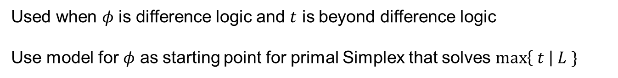
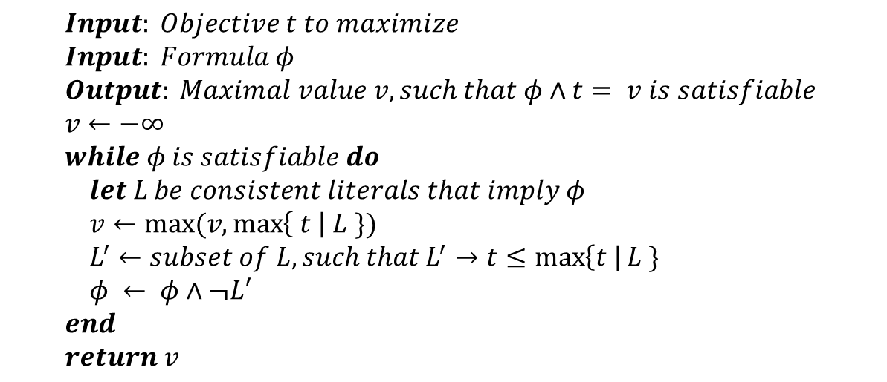
νZ for Weak Arithmetic
Maximization Directed Clause Learning
$$Input: Objective t to maximize \\ Input: Formula φ \\ Output: Maximal value v, such that φ∧t= v is satisfiable \\ v←−∞ \\ while φ is satisfiable do \\ let L be consistent literals that imply φ \\ v←max(v,max\left\{ t \right| L \}) \\ L^{′}←subset of L, such that L^{′}→t≤\max\left\{t \right|L \} \\ φ ← φ∧¬L′ \\ end \\ return v$$
Used when $φ$ is difference logic and $t$ is beyond difference logic
Use model for $φ$ as starting point for primal Simplex that solves $\max\left\{ t \right| L \}$

Slide 32
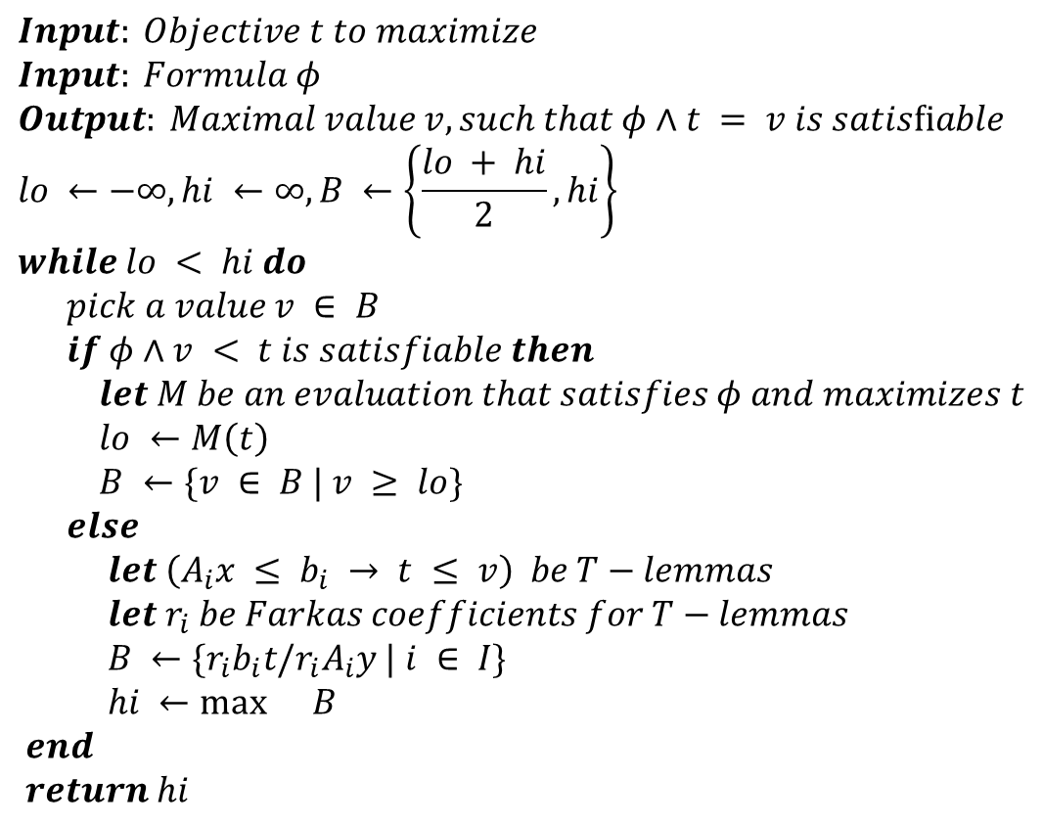
Learn from failure, a lá Bender
Farkas coefficients
$$Input: Objective t to maximize \\ Input: Formula φ \\ Output: Maximal value v, such that φ∧t = v is satisﬁable \\ lo ←−∞,hi ←∞, B ←\left\{\frac{lo + hi}{2},hi\right\} \\ while lo < hi do \\ pick a value v ∈ B \\ if φ∧v < t is satisfiable then \\ let M be an evaluation that satisfies φ and maximizes t \\ lo ←M\left(t\right) \\ B ←\{v ∈ B | v ≥ lo\} \\ else \\ let \left(A_{i}x ≤ b_{i} → t ≤ v\right) be T−lemmas \\ let r_{i} be Farkas coefficients for T−lemmas \\ B ←\{r_{i}b_{i}t/r_{i}A_{i}y | i ∈ I\} \\ hi ←\max{}B \\ end$$ $return hi$
Preliminary experience: unsat calls (else branch) are too expensive

Slide 33
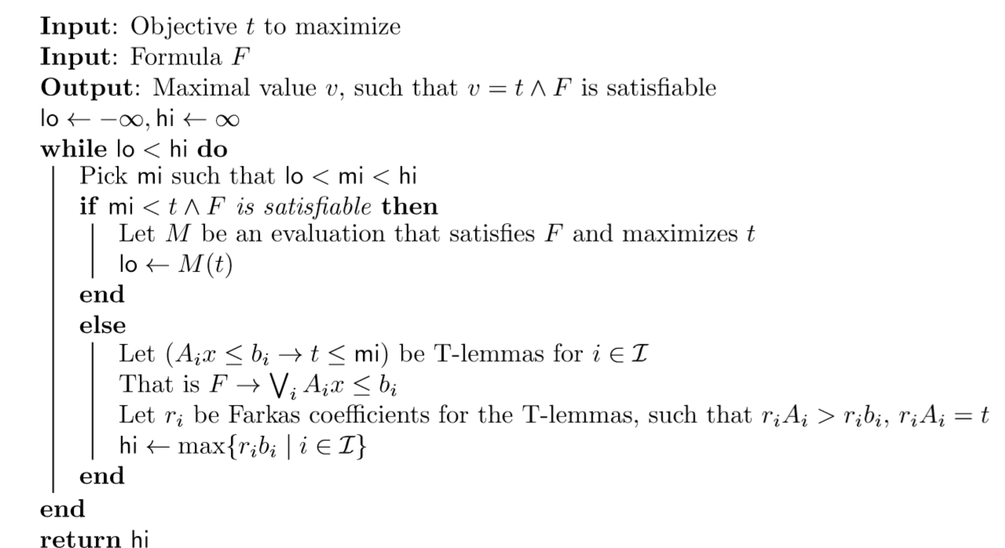
Learn from failure, a lá Bender
Farkas coefficients
Preliminary experience: unsat calls (else branch) are too expensive

Slide 34

νZ and MaxSAT/SMT
νZ and MaxSAT
Maximize $φ_{1}w_{1}+⋯+φ_{n}w_{n}$
$$φ_{1} {with penalty w}_{1}$$
MaxSAT $⋯$
$$φ_{n}{ with penalty w}_{n}$$

Slide 35
νZ for MaxSMT
Main approaches:
Portfolio of Algorithms for (weighted) MaxSAT:
Reduction to Pseudo Boolean [Chai, Kuehlmann ’03]
Solver-based [Nieuwenhuis, Oliveras ‘06]
Core-based [Fu, Malik ‘06]
Core and model guided [Heras et al. ‘10]
Core guided WPM2 [Ansótegui et al. ‘13]
Model and core guided BCD2 [Heras et al. ‘13]
Core, hitting sets, model [Davies et al. ‘13]
MaxRes [Narodytska et al. ‘14]
Custom CDCL(PB) solver
Stochastic Local Search to aid model-based approaches [Wintersteiger, Frolich]

Slide 36
Portfolio of strategies
Extract strong (many) explanations
to improve lower
bounds.
Core sweeping, Farkas
Decrease
Upper Bound
Models
Increase
Lower Bound
Cores
Walk model space to improve current
assignment.
SLS, Primal Simplex

Slide 37
CDCL(Weights & PB)
Tactics
SMT-LIB
SMT (legacy core)
Bit-Vectors
Arrays
Lin-arithmetic
Recursive Datatypes
Record & replay
Free functions
Quantifiers
Th(weights)
Pseudo Booleans
OCaml
And-then
SAT core for Bit-vectors
.NET
Or-else
∃R: Non-linear real arithmetic
C
Try-for
Floating point arithmetic
Java
Par-or
Horn clauses
Par-then
Simplification
Python

Slide 38
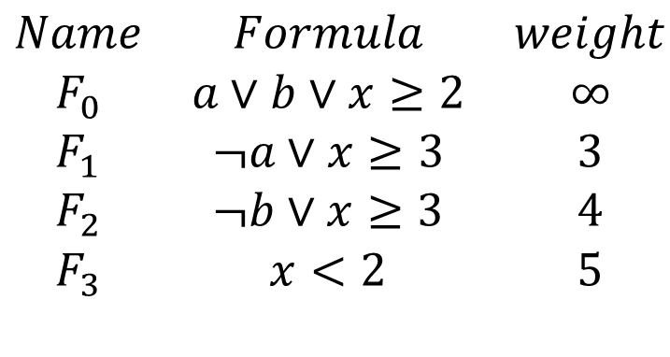
CDCL(Weights)
$$\begin{matrix}Name & Formula & weight \\ F_{0} & a∨b∨x≥2 & ∞ \\ F_{1} & ¬a∨x≥3 & 3 \\ F_{2} & ¬b∨x≥3 & 4 \\ F_{3} & x<2 & 5\end{matrix}$$
Unsat

Slide 39
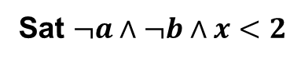
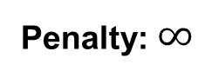
CDCL(Weights)
$$\begin{matrix}Name & Formula & weight \\ F_{0} & a∨b∨x≥2 & ∞ \\ F_{1} & ¬a∨x≥3 & 3 \\ F_{2} & ¬b∨x≥3 & 4 \\ F_{3} & x<2 & 5\end{matrix}$$
Penalty: $∞$
Sat $¬a∧¬b∧x<2$

Slide 40
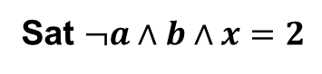
CDCL(Weights)
$$\begin{matrix}Name & Formula & weight \\ F_{0} & a∨b∨x≥2 & ∞ \\ F_{1} & ¬a∨x≥3 & 3 \\ F_{2} & ¬b∨x≥3 & 4 \\ F_{3} & x<2 & 5\end{matrix}$$
Sat $¬a∧b∧x=2$
Penalty: 9 = 4 + 5

Slide 41
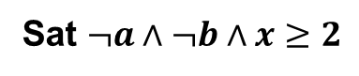
CDCL(Weights)
$$\begin{matrix}Name & Formula & weight \\ F_{0} & a∨b∨x≥2 & ∞ \\ F_{1} & ¬a∨x≥3 & 3 \\ F_{2} & ¬b∨x≥3 & 4 \\ F_{3} & x<2 & 5\end{matrix}$$
Sat $¬a∧¬b∧x≥2$
Penalty: 5

Slide 42
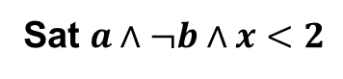
CDCL(Weights)
$$\begin{matrix}Name & Formula & weight \\ F_{0} & a∨b∨x≥2 & ∞ \\ F_{1} & ¬a∨x≥3 & 3 \\ F_{2} & ¬b∨x≥3 & 4 \\ F_{3} & x<2 & 5\end{matrix}$$
Penalty: 3
Sat $a∧¬b∧x<2$

Slide 43
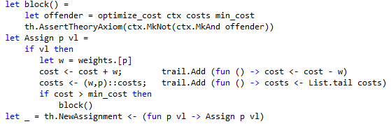
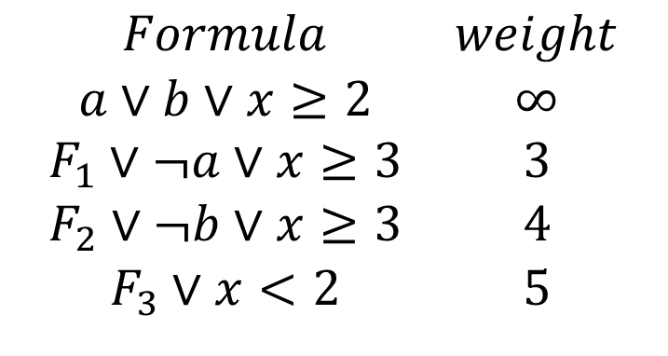
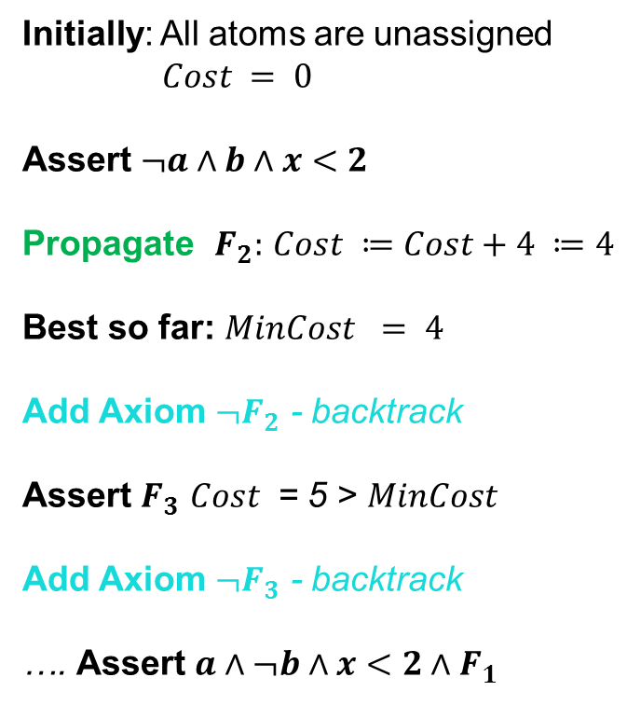
CDCL(Weights)
$$\begin{matrix}Formula & weight \\ a∨b∨x≥2 & ∞ \\ F_{1}∨¬a∨x≥3 & 3 \\ F_{2}∨¬b∨x≥3 & 4 \\ F_{3}∨x<2 & 5\end{matrix}$$
Initially: All atoms are unassigned
$Cost = 0$
Assert $¬a∧b∧x<2$
Propagate: $F_{2}:$ $Cost ≔Cost+4 ≔4$
Best so far: $MinCost = 4$
Add Axiom ${¬F}_{2}$ - backtrack
Assert $F_{3}$ $Cost$ = 5 > $MinCost$
Add Axiom ${¬F}_{3}$ - backtrack
…. Assert $a∧¬b∧x<2∧F_{1}$
What does it take to encode this in Z3?
[Oliveras, Nieuenhuis, SAT 06]

Slide 44
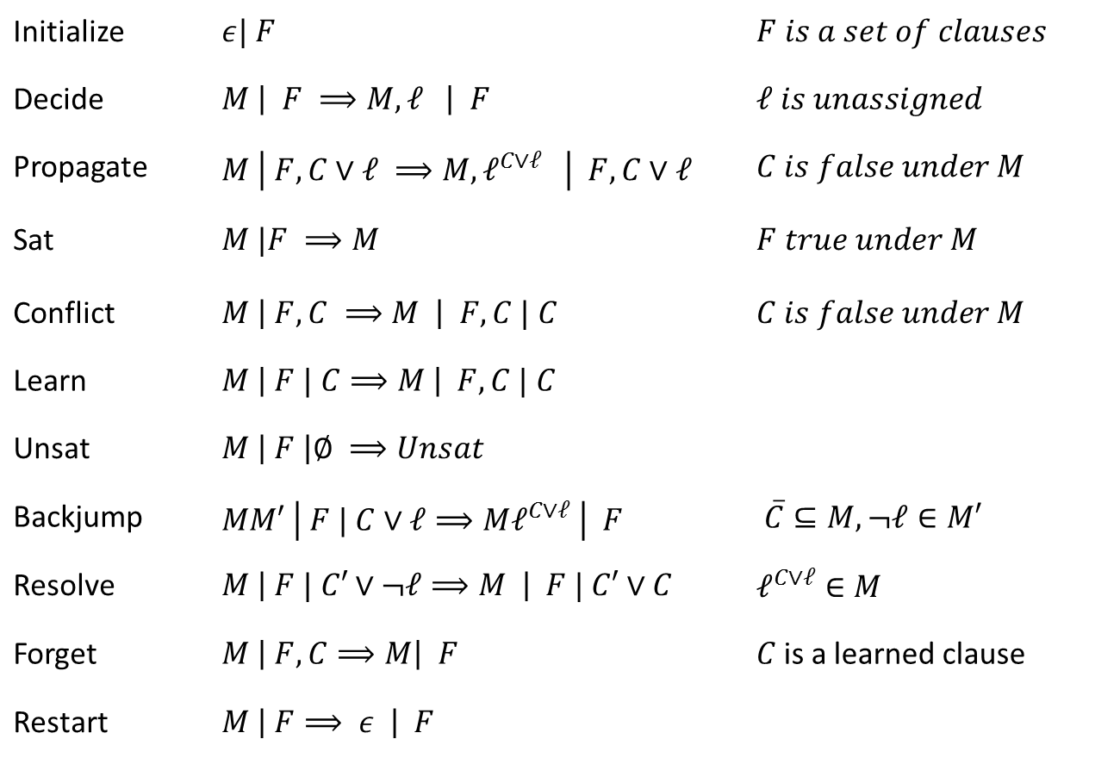
Core Engine in Z3: Modern DPLL/CDCL
Initialize | $ε| F$ | $F is a set of clauses$
Decide | $M \left| F ⟹M, ℓ \right| F$ | $ℓ is unassigned$
Propagate | $M \left| F, C∨ℓ ⟹M, ℓ^{C∨ℓ} \right| F,C∨ℓ$ | $C is false under M$
Sat | $M |F ⟹M$ | $F true under M$
Conflict | $M \left| F, C ⟹M \right| F,C | C$ | $C is false under M$
Learn | $M \left| F | C⟹M \right| F, C | C$
Unsat | $M \left| F \right|∅ ⟹Unsat$
Backjump | $MM′ \left| F | C∨ℓ⟹Mℓ^{C∨ℓ} \right| F$ | $\overline{C}⊆M, ¬ℓ∈M′$
Resolve | $M \left| F | C′∨¬ℓ⟹M \right| F | C′∨C$ | $ℓ^{C∨ℓ}∈M$
Forget | $M \left| F, C⟹M\right| F$ | $C$is a learned clause
Restart | $M \left| F⟹ ε \right| F$
Model
Proof
Conflict
Resolution
[Nieuwenhuis, Oliveras, Tinelli J.ACM 06] customized

Slide 45
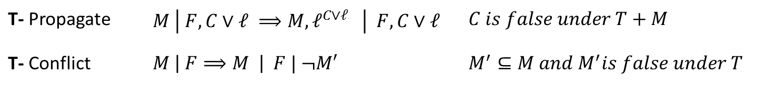
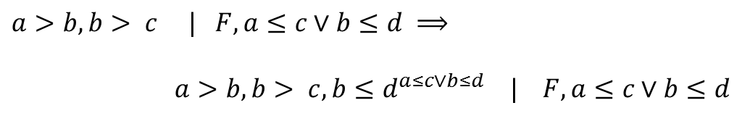
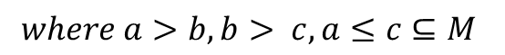
CDCL(T) solver interaction
T- Propagate | $M \left| F, C∨ℓ ⟹M, ℓ^{C∨ℓ} \right| F,C∨ℓ$ | $C is false under T+M$
T- Conflict | $M \left| F⟹M \right| F | ¬M′$ | $M^{′}⊆M and M^{′}is false under T$
T- Propagate
$a>b, b> c | F, a≤c∨b≤d ⟹$
$a>b, b> c, b≤d^{a≤c∨b≤d} | F, a≤c∨b≤d$
T- Conflict
$M | F⟹$ $M | F, a≤b∨b≤c∨c<a$
$$where a>b, b> c, a≤c⊆M$$

Slide 46
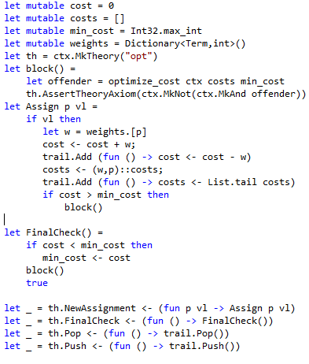
CDCL(Weights) Solver Interaction
Calls into DPLL engine
T-Propagate
T-Conflict
Callbacks from DPLL engine
Callbacks from DPLL engine with new assignment
T-Propagate
T-Conflict
Calls into DPLL engine

Slide 47
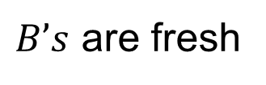
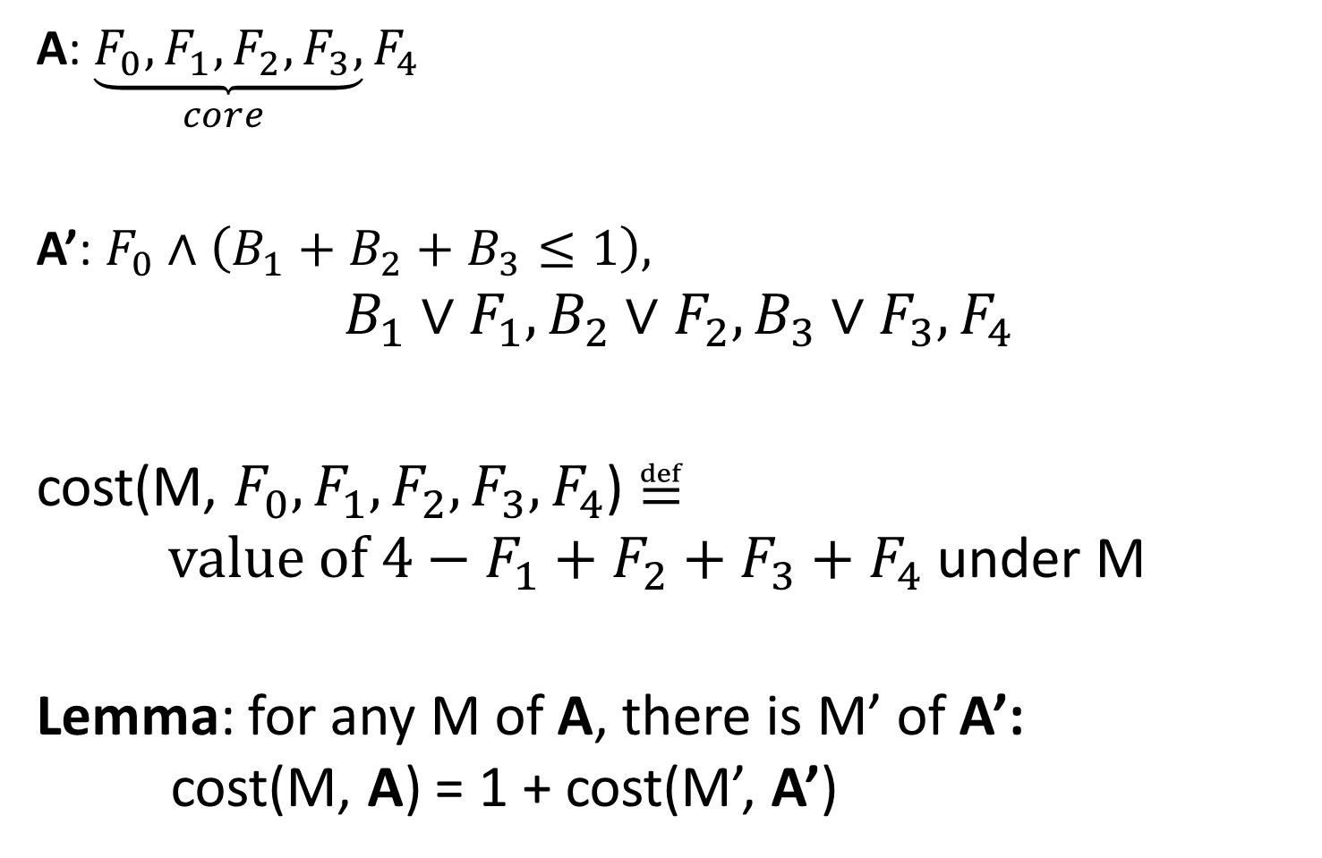
Fu & Malik 2006
A: $\underset{core }{\underbrace{{F_{0}, F}_{1},F_{2}, F_{3},}}F_{4}$
A’: ${F_{0}∧\left(B_{1}+B_{2}+B_{3}≤1\right),}_{}$
$${B_{1}∨F}_{1},{B_{2}∨F}_{2},{B_{3}∨F}_{3}, F_{4}$$
cost(M, ${{F_{0}, F}_{1},F_{2}, F_{3}, F}_{4}$) $≝$ $value of {{4−F}_{1}+F_{2}+F_{3}+F}_{4}$ under M
Lemma: for any M of A, there is M’ of A’: cost(M, A) = 1 + cost(M’, A’)
$B’s$ are fresh

Slide 48
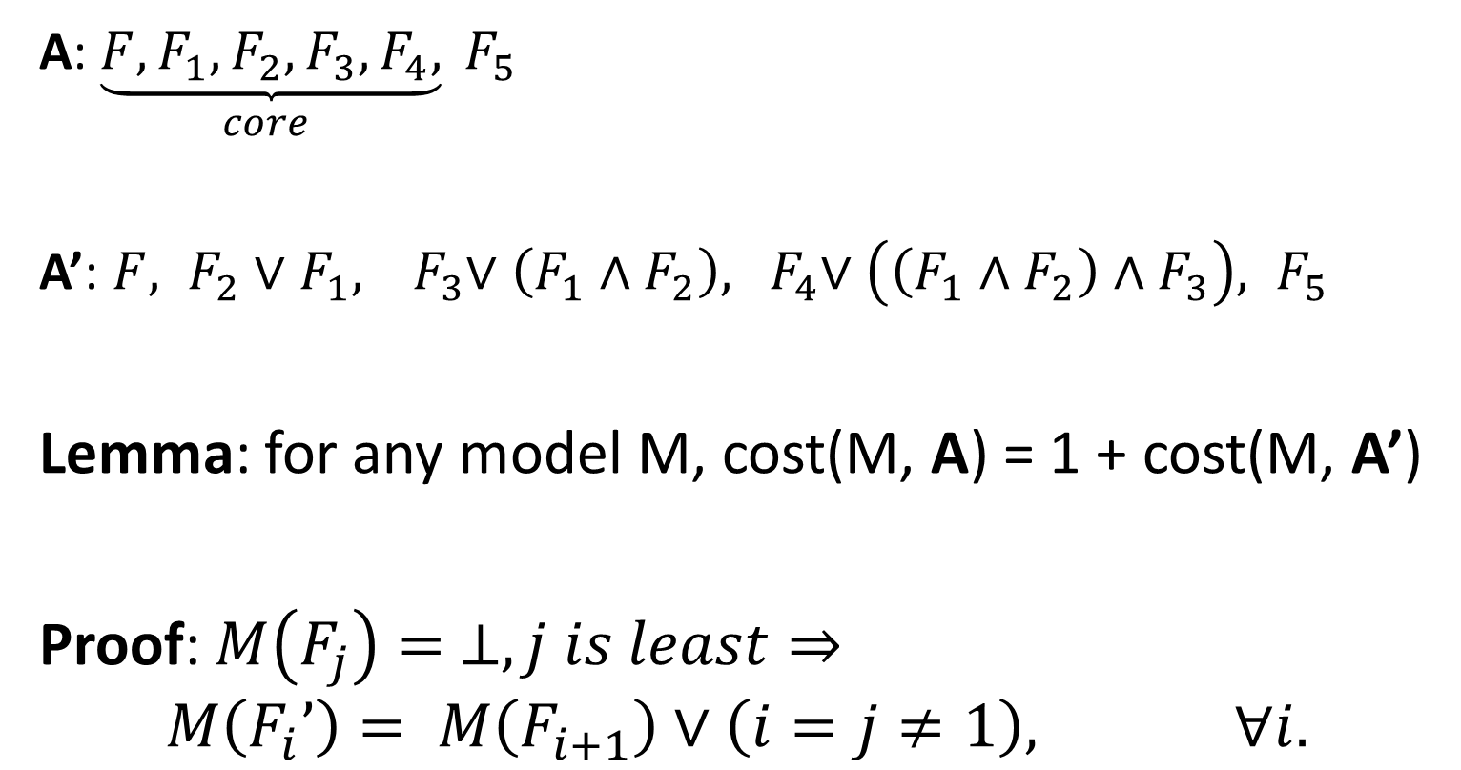
MaxRes
[Narodytska & Bacchus. ’14, AAAI] (implicit MaxRes version)
A: $\underset{core }{\underbrace{{F, F}_{1},F_{2}, F_{3},F_{4},}} F_{5}$
A’: ${F, F}_{2}∨F_{1}, { F}_{3}∨\left(F_{1}∧F_{2}\right), { F}_{4}∨\left(\left(F_{1}∧F_{2}\right)∧F_{3}\right), F_{5}$
Lemma: for any model M, cost(M, A) = 1 + cost(M, A’)
Proof: $M\left(F_{j}\right)= ⊥, j is least⇒$
$$M\left(F_{i}’\right)= M\left(F_{i+1}\right)∨\left(i=j≠1\right), ∀i.$$

Slide 49
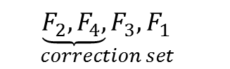
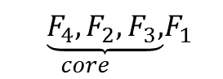





Cores and Correction Sets
$\underset{core }{\underbrace{F_{1},F_{2}, F_{3},}}F_{4}$
${{ F}_{1},F_{2},\underset{correction set }{\underbrace{F_{3}}},F_{4}}_{}$
$\underset{core }{\underbrace{F_{4},F_{2}, F_{3},}}F_{1}$
$${ \underset{correction set }{\underbrace{F_{1}, F_{2},}F_{3},F_{4}} }_{}$$
${\underset{correction set }{\underbrace{F_{1}, F_{4},}F_{3},F_{2}} }_{}$
$\underset{core }{\underbrace{F_{1},F_{4}, F_{3},}}F_{2}$
${\underset{correction set }{\underbrace{F_{2}, F_{4},}F_{3},F_{1}} }_{}$

Slide 50

Dual MaxRes
Narodytska & Bjørner (a dual twist)
A: $\underset{correction set }{\underbrace{{F, F}_{1},F_{2}, F_{3},F_{4},}} F_{5}$
A’: $F∧(F_{1}∨F_{2}{∨F}_{3}∨F_{4}),$
$$F_{2}∧F_{1}, { F}_{3}∧\left(F_{1}∨F_{2}\right), { F}_{4}∧\left(\left(F_{1}∨F_{2}\right)∨F_{3}\right), { F}_{5}$$
Lemma: for any M of A’, cost(M, A) = cost(M, A’)
Proof: $M\left(F_{j}\right)=⊤, j is least⇒$
$M\left(F_{i}’\right)= M\left(F_{i+1}\right)∧\left(i≠j∨j=1\right), ∀i.$

Slide 51

CDCL(PB)
PB Constraints: $\sum_{i}{a_{i}ℓ_{i}≥b}$, $\sum_{i}{a_{i}ℓ_{i}=b}$ Cardinality is a special case: $\sum_{i}{ℓ_{i}≥c}$
PB solver is a satellite theory to Z3’s core CDCL engine.
Integration with other theories “for free”.

Slide 52
CDCL(PB)
Propagation
Conflict Resolution [Chai et.al. ‘03]
Sorting Circuits [Abío et.al. ‘13]
Simplex over 0-1 constraints
Extract clauses from LP infeasible certificates

Slide 53
Observations
Resolution poor at equalities (well known)
Simplex helps
PB Conflict Resolution is pretty expensive
Sorting Circuits help (of course), but
Simplex helps elsewhere

Slide 54

Combining Objectives
Combining
Objectives
Box$(x,y)$: $ν_{x}≔max\left\{x \right|φ\left(x,y\right)\}$
$ν_{y}≔max\left\{y \right|φ\left(x,y\right)\}$
Lex$(x,y)$: $ν_{x}≔max\left\{x \right|φ\left(x,y\right)\}$
$ν_{y}≔max\left\{y \right|φ\left(ν_{x},y\right)\}$
Pareto$(x,y)$: $ν_{x}{,ν}_{y}≔{φ\left(ν_{x}{,ν}_{y}\right)}$, $$∀x,y.φ\left(x,y\right)→¬(\left(x,y\right)>\left(ν_{x}{,ν}_{y}\right))$$

Slide 55

νZ Basic Box Optimization
$$Input: Objective t_{1},t_{2} to maximize \\ Input: Formula φ \\ Output: Min values v_{1}{,v}_{2}, such that φ→t_{1}≤v_{1}∧t_{2}≤v_{2} is valid \\ v_{1},v_{2}←−∞ \\ while φ is satisfiable do \\ let M_{i} be evaluations that satisfy φ and maximize t_{i} \\ v_{1} ←M_{1}\left(t_{1}\right), { v}_{2}←M_{2}\left(t_{2}\right), \\ φ ← φ∧(t_{1} > v_{1}∨t_{2}>v_{2}) \\ end \\ return v_{1},v_{2}$$

Slide 56

Weak Lexicographic Products
Current simplification in implementation:
Assert also literals that were used in MaxSMT assignment.
Lex$(x,y)$: $ν_{x},L_{x}≔max\left\{(x,L) \right|L⊨φ\left(x,y\right)\}$
$ν_{y}≔max\left\{y \right|L_{x}∧φ\left(ν_{x},y\right)\}$
The value of $ν_{y}$ may not be optimal

Slide 57

νZ Pareto Optimization
$Input: Objective t_{1},t_{2} to maximize$ $Input: Formula φ$ $Output:Pareto\max{front}$ $while φ is satisfiable do$
$ψ←φ$
$while ψ is satisfiable do$
$let M be an evaluation that satisﬁes ψ$ $v_{1} ←M\left(t_{1}\right), { v}_{2}←M\left(t_{2}\right),$ $ψ←ψ∧t_{1}≥v_{1}∧t_{2}≥v_{2}∧(t_{1} > v_{1}∨t_{2}>v_{2})$ $φ ← φ∧\left(t_{1} > v_{1}∨t_{2}>v_{2}\right)$
o$utput v_{1},v_{2}$
$end$
Guided Improvement Algorithm [Rayside, Estler, Jackson, MIT-TR 2009]
Our incarnation is simple. Current work on GIA includes parallelization, incrementality, check-pointing [at U. Waterloo]. For linear arithmetic, a possible enhancement is to use primal simplex to improve M.

Slide 58
νZ - Summary
νZ integrates and extends many new algorithms from MaxSAT, linear optimization, combination methods.
νZ is still very actively being improved based on benchmarks and case studies obtained from Z3 users.

